Slide 1
Data Manipulation with Pandas
PANDAS

Slide 2
Data Manipulation with Pandas
Introducing Pandas Objects
Data indexing and Selection
Operating on Data in Pandas
Handling Missing Data
Hierarchical Indexing
Combining Datasets: Concat and Append
Combining Datasets: Merge and Join
Aggregation and Grouping
Pivot Tables
Visualize data with pandas

Slide 3

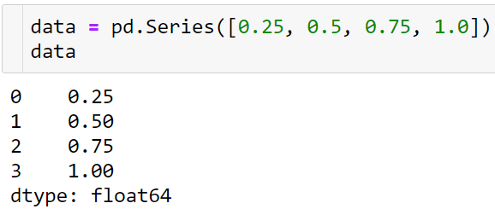
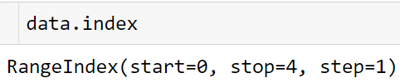
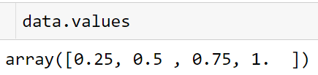

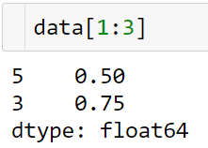
Introducing Pandas Objects
At the very basic level, Pandas objects can be thought of as enhanced versions of NumPy structured arrays in which the rows and columns are identified with labels rather than simple integer indices.
The Pandas Series Object
A Pandas Series is a one-dimensional array of indexed data

Slide 4
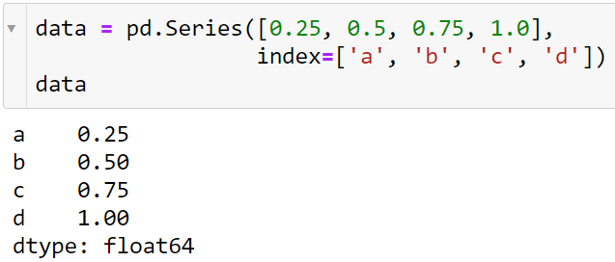
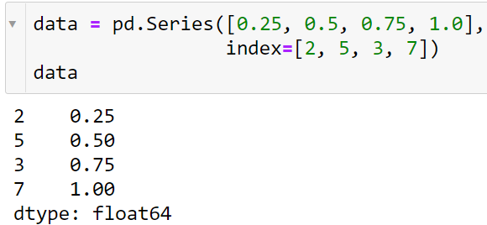
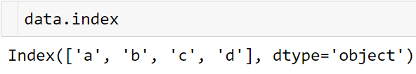
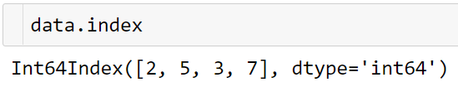

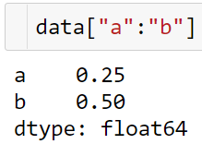

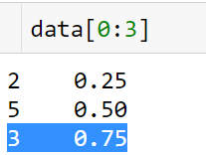
Introducing Pandas Objects
Series as generalized NumPy array

Slide 5
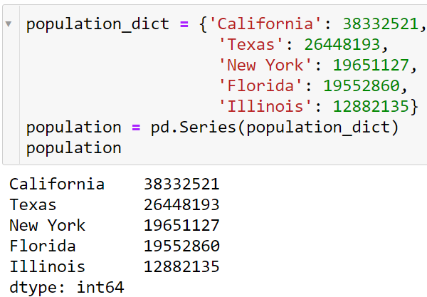
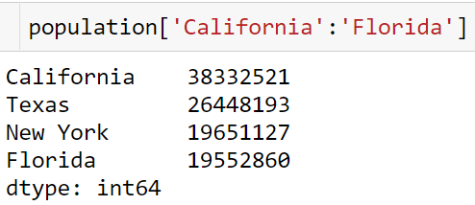
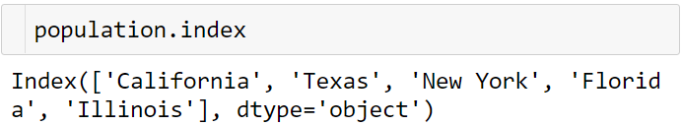

Introducing Pandas Objects
Series as specialized dictionary
Unlike a dictionary, though, the Series also supports array-style operations such as slicing:

Slide 6
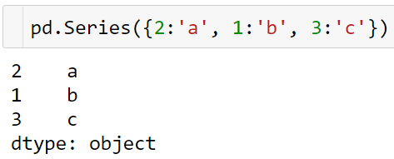
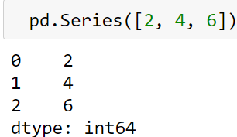
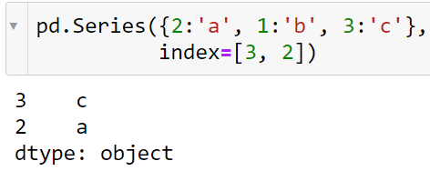
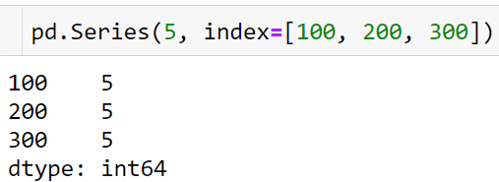
Introducing Pandas Objects
pd.Series(data, index=index)
Constructing Series objects
where index is an optional argument, and data can be one of many entities.
Data can be a scalar, which is repeated to fill the specified index:
Notice that in this case, the Series is populated only with the explicitly identified keys.

Slide 7
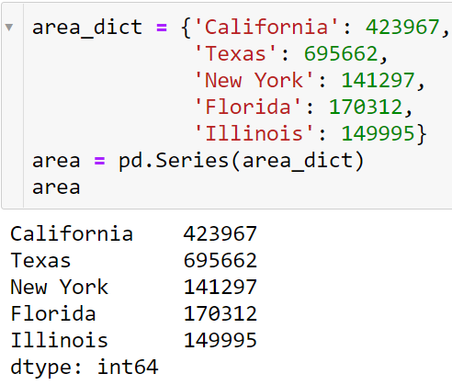
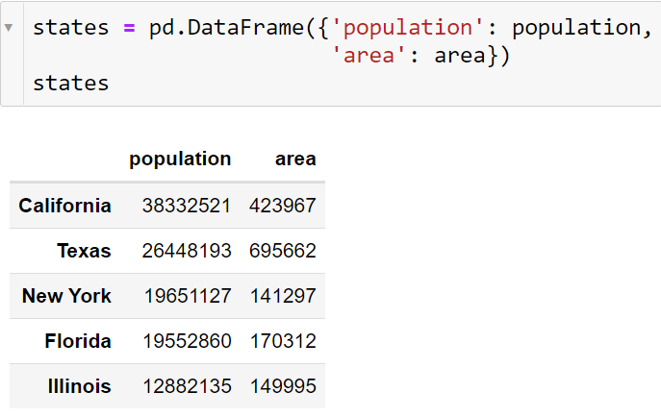
Introducing Pandas Objects
The Pandas DataFrame Object
DataFrame as a generalized NumPy array
States.column
States.index

Slide 8
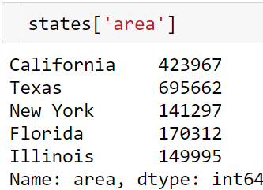
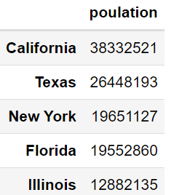
Introducing Pandas Objects
DataFrame as specialized dictionary
Constructing DataFrame objects A Pandas DataFrame can be constructed in a variety of ways
From a single Series object.

Slide 9
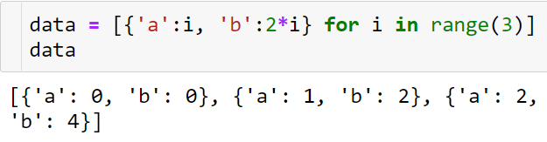
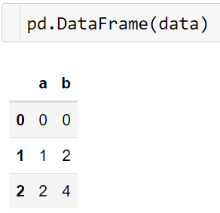
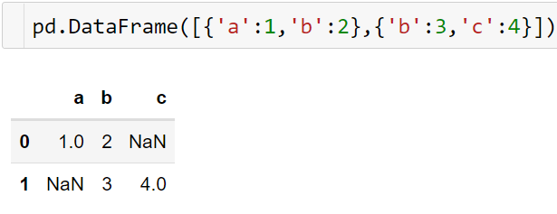
Introducing Pandas Objects
From a list of dicts
Even if some keys in the dictionary are missing, Pandas will fill them in with NaN (i.e., "not a number") values
“Not a number”

Slide 10
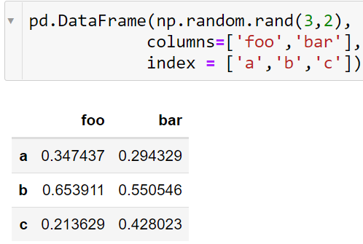
Introducing Pandas Objects
From a dictionary of Series objects
From a two-dimensional NumPy array
As we saw before, a DataFrame can be constructed from a dictionary of Series objects as well:
Given a two-dimensional array of data, we can create a DataFrame with any specified column and index names. If omitted, an integer index will be used for each:

Slide 11
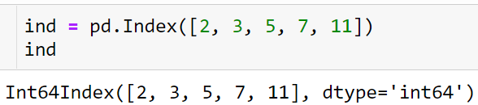
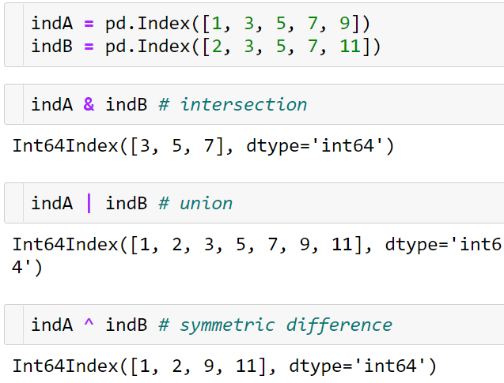



Introducing Pandas Objects
The Pandas Index Object
We have seen here that both the Series and DataFrame objects contain an explicit index that lets you reference and modify data. This Index object is an interesting structure in itself, and it can be thought of either as an immutable array or as an ordered set
Index as ordered set
Index as immutable array

Slide 12


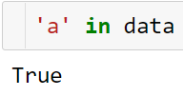
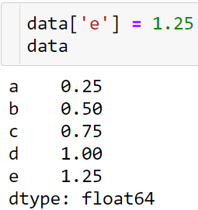
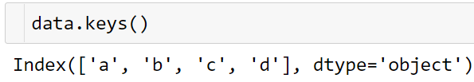
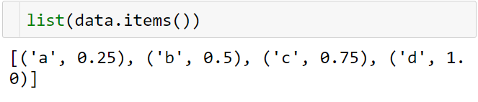
Data indexing and Selection
Data Selection in Series
Series as dictionary

Slide 13
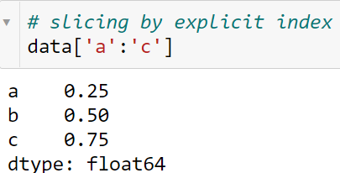
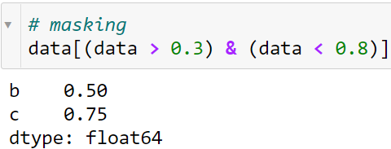
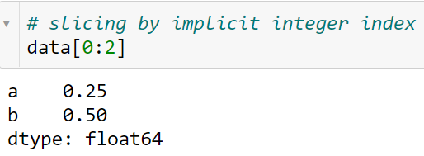
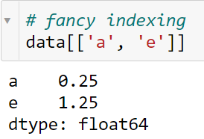
Data indexing and Selection
Series as one-dimensional array

Slide 14
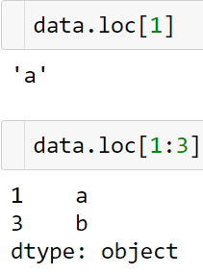
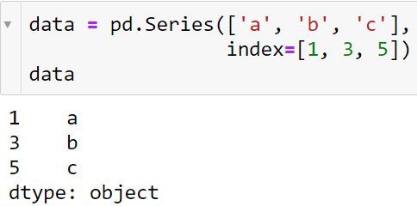
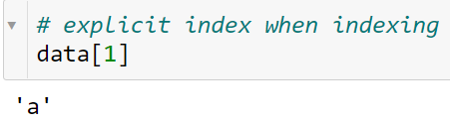
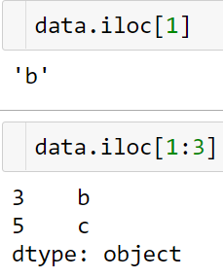
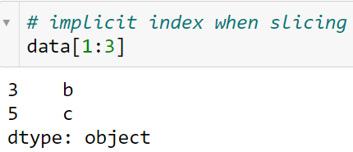
Data indexing and Selection
Indexers: loc, iloc
The loc attribute allows indexing and slicing that always references the explicit index.
The iloc attribute allows indexing and slicing that always references the implicit Python-style index.

Slide 15
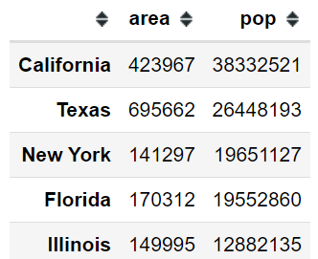
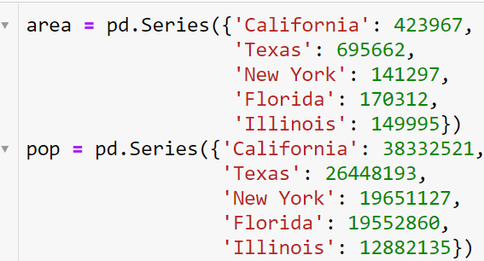
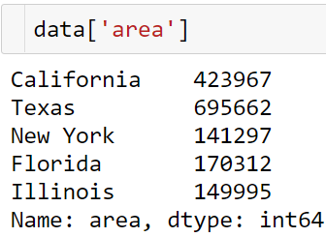


Data indexing and Selection
Data Selection in DataFrame
DataFrame as a dictionary

Slide 16
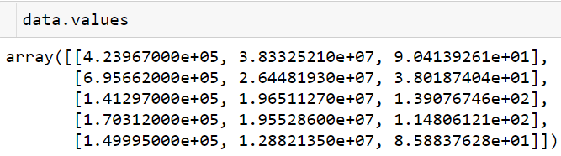
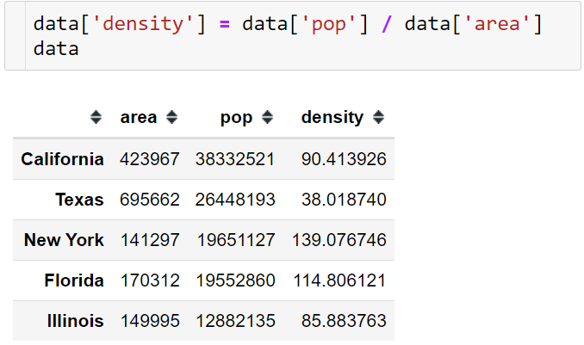

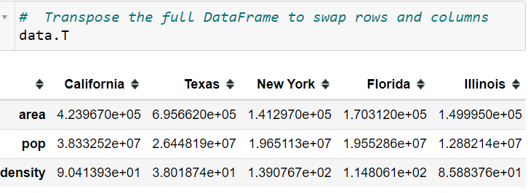
Data indexing and Selection
DataFrame as two-dimensional array

Slide 17
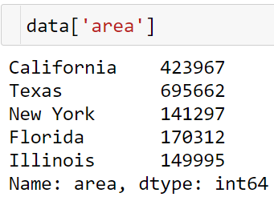
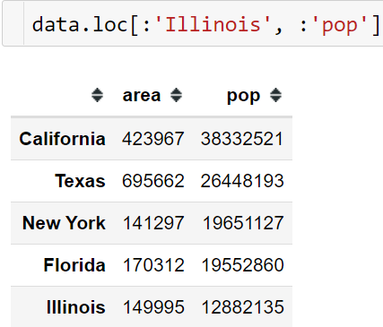
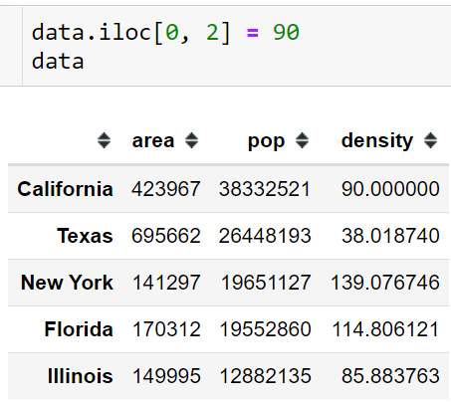
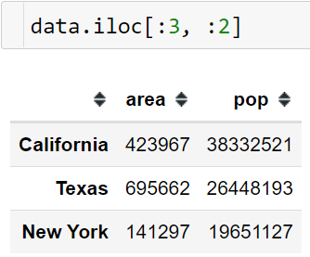

Data indexing and Selection
The loc indexer we can combine masking and fancy indexing.

Slide 18



Data indexing and Selection
Additional indexing conventions
while indexing refers to columns, slicing refers to rows.
Such slices can also refer to rows by number rather than by index:
Similarly, direct masking operations are also interpreted row-wise rather than column-wise:

Slide 19




Operating on Data in Pandas
Index Preservation

Slide 20




Operating on Data in Pandas
Index Alignment
Index alignment in Series
The resulting array contains the union of indices of the two input arrays

Slide 21



Operating on Data in Pandas
Index alignment in DataFrame
A similar type of alignment takes place for both columns and indices when performing operations on DataFrames.
Notice that indices are aligned correctly irrespective of their order in the two objects, and indices in the result are sorted.

Slide 22



Operating on Data in Pandas
As was the case with Series, we can use the associated object's arithmetic method and pass any desired fill_value to be used in place of missing entries.
4.5

Slide 23



Operating on Data in Pandas
Operations Between DataFrame and Series
According to NumPy's broadcasting rules, subtraction between a two-dimensional array and one of its rows is applied row-wise.
In Pandas, the convention similarly operates row-wise by default:

Slide 24




Operating on Data in Pandas
If you would instead like to operate column-wise, you can use the object methods mentioned earlier, while specifying the axis keyword:
Note that these DataFrame/Series operations, like the operations discussed above, will automatically align indices between the two elements:

Slide 25
Handling Missing Data
We'll refer to missing data in general as null, NaN, or NA values.
Trade-Offs in Missing Data Conventions
There are a number of schemes that have been developed to indicate the presence of missing data in a table or DataFrame. Generally, they revolve around one of two strategies: using a mask that globally indicates missing values, or choosing a sentinel value that indicates a missing entry.
None of these approaches is without trade-offs: use of a separate mask array requires allocation of an additional Boolean array, which adds overhead in both storage and computation. A sentinel value reduces the range of valid values that can be represented, and may require extra (often non-optimized) logic in CPU and GPU arithmetic. Common special values like NaN are not available for all data types.
Missing Data in Pandas

Slide 26



Handling Missing Data
None: Pythonic missing data
The first sentinel value used by Pandas is None, a Python singleton object that is often used for missing data in Python code. Because it is a Python object, None cannot be used in any arbitrary NumPy/Pandas array, but only in arrays with data type 'object’.
The use of Python objects in an array also means that if you perform aggregations like sum() or min() across an array with a None value, you will generally get an error:

Slide 27





Handling Missing Data
NaN: Missing numerical data
NumPy does provide some special aggregations that will ignore these missing values:
Note that this means that aggregates over the values are well defined (i.e., they don't result in an error) but not always useful:

Slide 28


Handling Missing Data
NaN and None in Pandas
NaN and None both have their place, and Pandas is built to handle the two of them nearly interchangeably, converting between them where appropriate:
For types that don't have an available sentinel value, Pandas automatically type-casts when NA values are present

Slide 29



Handling Missing Data
Operating on Null Values
Pandas treats None and NaN as essentially interchangeable for indicating missing or null values. To facilitate this convention, there are several useful methods for detecting, removing, and replacing null values in Pandas data structures. They are:
Detecting null values: Pandas data structures have two useful methods for detecting null data: isnull() and notnull(). Either one will return a Boolean mask over the data.
The isnull() and notnull() methods produce similar Boolean results for DataFrames.

Slide 30





Handling Missing Data
Dropping null values
For a Series, the result is straightforward:
For a DataFrame, there are more options.
By default, dropna() will drop all rows in which any null value is present:
Alternatively, you can drop NA values along a different axis; axis=1 drops all columns containing a null value:

Slide 31



Handling Missing Data
But this drops some good data as well; you might rather be interested in dropping rows or columns with all NA values, or a majority of NA values. This can be specified through the how or thresh parameters, which allow fine control of the number of nulls to allow through.
The default is how='any', such that any row or column (depending on the axis keyword) containing a null value will be dropped. You can also specify how='all', which will only drop rows/columns that are all null values:
For finer-grained control, the thresh parameter lets you specify a minimum number of non-null values for the row/column to be kept:

Slide 32


Handling Missing Data
Filling null values
Sometimes rather than dropping NA values, you'd rather replace them with a valid value. This value might be a single number like zero, or it might be some sort of imputation or interpolation from the good values.
You could do this in-place using the isnull() method as a mask, but because it is such a common operation Pandas provides the fillna() method, which returns a copy of the array with the null values replaced.
We can fill NA entries with a single value, such as zero:

Slide 33




Handling Missing Data
Forward-fill or a back-fill.
For DataFrames, the options are similar, but we can also specify an axis along which the fills take place:
Notice that if a previous value is not available during a forward fill, the NA value remains.

Slide 34



Hierarchical Indexing
A Multiply Indexed Series
you can straightforwardly index or slice the series based on this multiple index:
The bad way

Slide 35



Hierarchical Indexing
The Better Way: Pandas MultiIndex
Here the first two columns of the Series representation show the multiple index values, while the third column shows the data.
Notice that some entries are missing in the first column: in this multi-index representation, any blank entry indicates the same value as the line above it.

Slide 36


Hierarchical Indexing
MultiIndex as extra dimension
The unstack() method will quickly convert a multiply indexed Series into a conventionally indexed DataFrame
Naturally, the stack() method provides the opposite operation:

Slide 37


Hierarchical Indexing

Slide 38


Hierarchical Indexing
Methods of MultiIndex Creation
Similarly, if you pass a dictionary with appropriate tuples as keys, Pandas will automatically recognize this and use a MultiIndex by default:
The most straightforward way to construct a multiply indexed Series or DataFrame is to simply pass a list of two or more index arrays to the constructor.

Slide 39



Hierarchical Indexing
Explicit MultiIndex constructors
You can construct it from a list of tuples giving the multiple index values of each point:
For more flexibility in how the index is constructed, you can instead use the class method constructors available in the pd.MultiIndex
You can even construct it from a Cartesian product of single indices:

Slide 40

Hierarchical Indexing
MultiIndex level names
Sometimes it is convenient to name the levels of the MultiIndex
With more involved datasets, this can be a useful way to keep track of the meaning of various index values.

Slide 41



Hierarchical Indexing
MultiIndex for columns
In a DataFrame, the rows and columns are completely symmetric, and just as the rows can have multiple levels of indices, the columns can have multiple levels as well.

Slide 42




Hierarchical Indexing
Indexing and Slicing a MultiIndex
Indexing and slicing on a MultiIndex is designed to be intuitive, and it helps if you think about the indices as added dimensions
Multiply indexed Series
We can access single elements by indexing with multiple terms:

Slide 43



Hierarchical Indexing
Selection based on fancy indexing also works

Slide 44


Hierarchical Indexing
Multiply indexed DataFrames
A multiply indexed DataFrame behaves in a similar manner.
Remember that columns are primary in a DataFrame, and the syntax used for multiply indexed Series applies to the columns.

Slide 45




Hierarchical Indexing
Working with slices within these index tuples is not especially convenient; trying to create a slice within a tuple will lead to a syntax error:
You could get around this by building the desired slice explicitly using Python's built-in slice() function, but a better way in this context is to use an IndexSlice object, which Pandas provides for precisely this situation.

Slide 46


Hierarchical Indexing
Rearranging Multi-Indices
Sorted and unsorted indices
If we try to take a partial slice of this index, it will result in an error:
Although it is not entirely clear from the error message, this is the result of the MultiIndex not being sorted

Slide 47


Hierarchical Indexing
Pandas provides a number of convenience routines to perform this type of sorting; examples are the sort_index() and sortlevel() methods of the DataFrame. We'll use the simplest, sort_index(), here:
With the index sorted in this way, partial slicing will work as expected:

Slide 48



Hierarchical Indexing
Stacking and unstacking indices
As we saw briefly before, it is possible to convert a dataset from a stacked multi-index to a simple two-dimensional representation, optionally specifying the level to use:
The opposite of unstack() is stack(), which here can be used to recover the original series:

Slide 49


Hierarchical Indexing
Index setting and resetting
Often when working with data in the real world, the raw input data looks like this and it's useful to build a MultiIndex from the column values.
Another way to rearrange hierarchical data is to turn the index labels into columns; this can be accomplished with the reset_index method

Slide 50


Hierarchical Indexing
Data Aggregations on Multi-Indices
Perhaps we'd like to average-out the measurements in the two visits each year. We can do this by naming the index level we'd like to explore, in this case the year:
Let's return to our health data:
Thus in two lines, we've been able to find the average heart rate and temperature measured among all subjects in all visits each year

